Slide 1
THESIS PRESENTATION
Kanishk Yadav
Clean Energy Lab
University of Toronto
Supervised by Prof. Oleksandr Voznyy & Co-supervised by Prof. K Sumithra

Slide 2
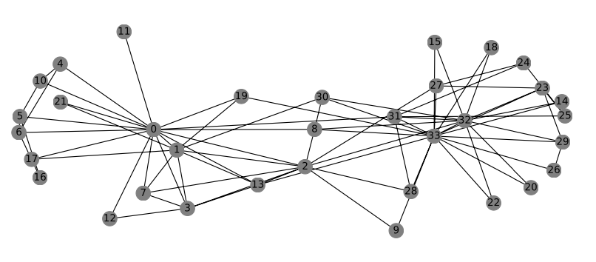
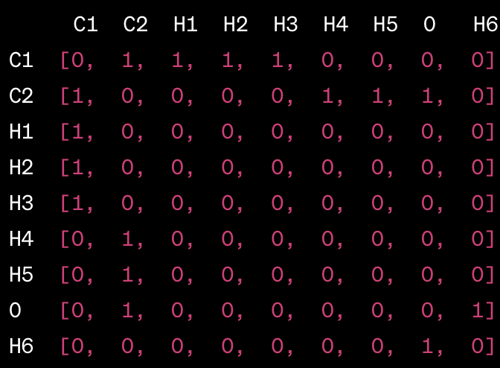
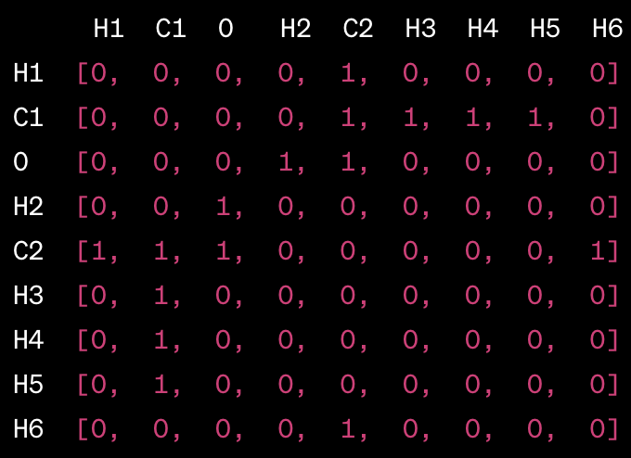
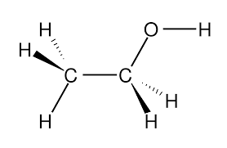
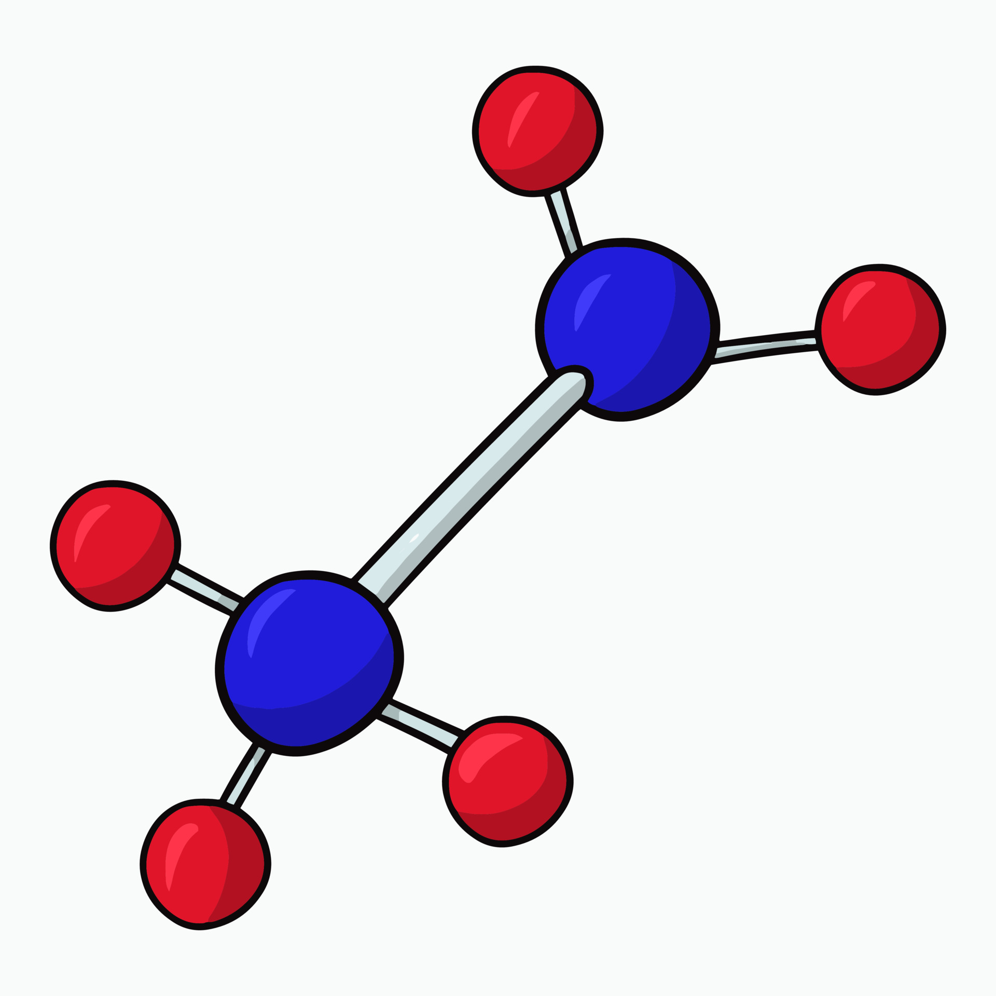
GRAPH NEURAL NETWORKS in chemistry
How do we represent molecules?
Complex, non-fixed size, no fixed node ordering, no notion of reference point
C₂H₅OH (need for non-permutation invariance)
Need for GNNs
Node order: C, C, H, H, H, H, H, O, H
Node order: H, C, O, H, C, H, H, H, H

Slide 3
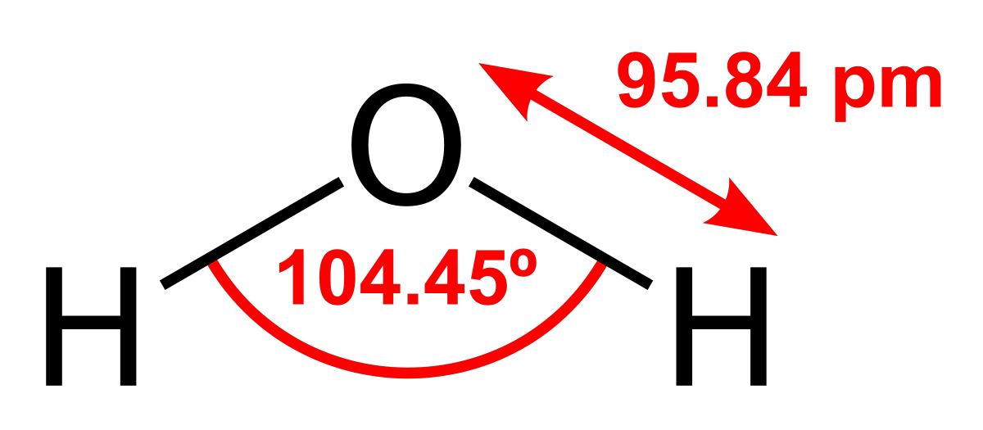
Feature representation
Distinctive attributes of data capturing relevant information
Node (atom) features: Atomic number, valency, electronegativity, atomic radius
Edge (bond) features: Bond type, bond length, bond angle
Graph-level (molecule) features: Polarity, number of rings, aromaticity
node
O: [8(atomic number), 2(valence), 3.44(electronegativity), 60(atomic number)]
H: [1(atomic number), 1(valence), 2.20(electronegativity), 31(atomic number)]
O-H: [1(single bond), 95.84(bond length), 104.5(bond angle)]
edge

Slide 4
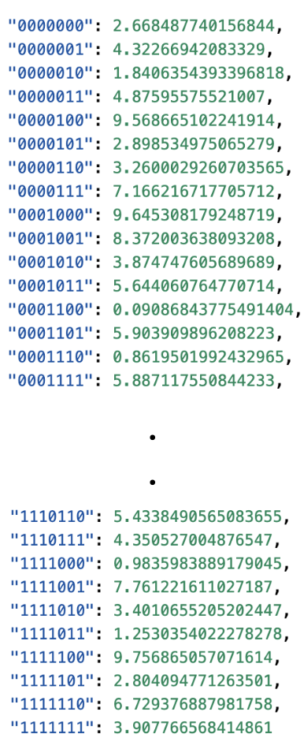
THE SUMMATION PROBLEM
Reverse-engineer the properties of atoms by studying the molecules they form
Learn about the properties of individual atoms (real number) based on the properties of the molecules (sum of individual real numbers) without directly observing the atoms
Binary representation of data (7 bits - 128 atoms)
Dataset
Goal is to learn about the atom value using only its binary representation and the sum it generates with other atoms in molecule
(0000000, 0000001, 000010) = 2.668 + 4.322 + 1.840 = 8.83
0 | 0 | 0 | 0 | 0 | 0 | 0
1 | 1 | 1 | 1 | 1 | 1 | 1
0 | 0 | 0 | 0 | 0 | 0 | 0 | 0 | 0 | 0 | 0 | 0 | 0 | 1 | 0 | 0 | 0 | 0 | 0 | 1 | 0

Slide 5
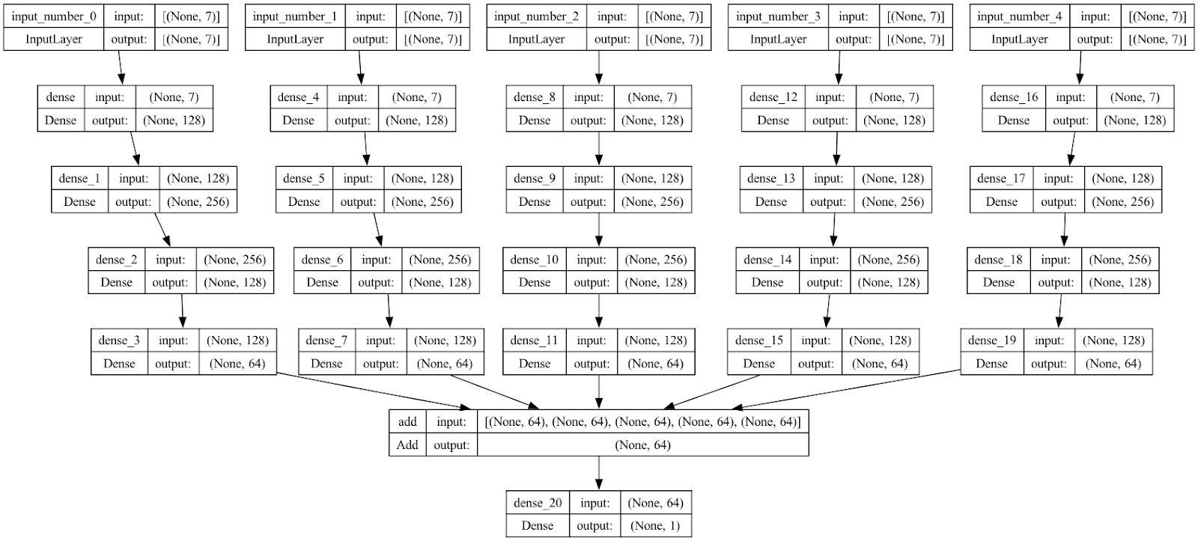
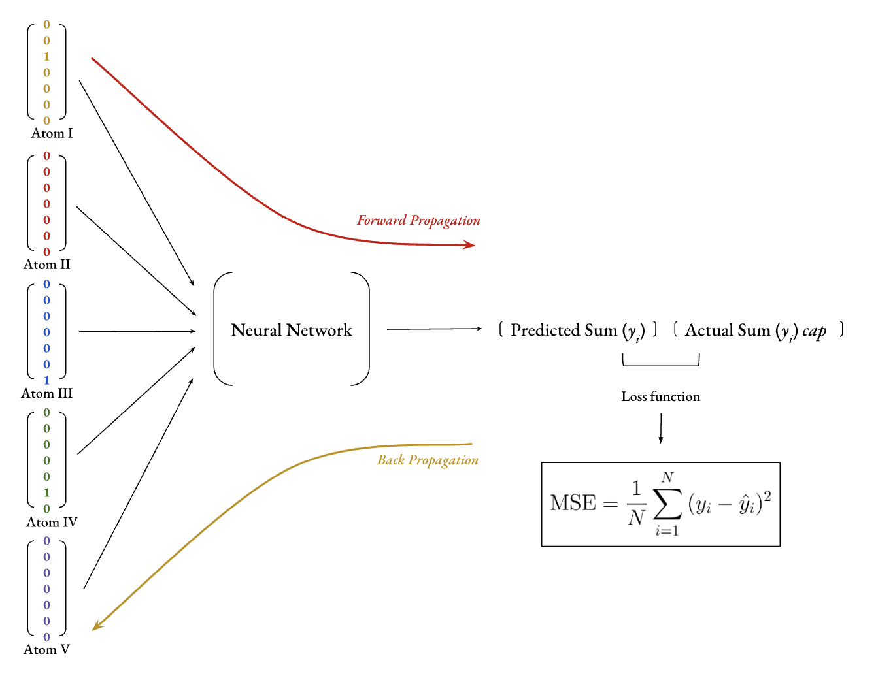
Network architecture
5 atom version (128⁵)
n atom version (128^{n} combinations)

Slide 6
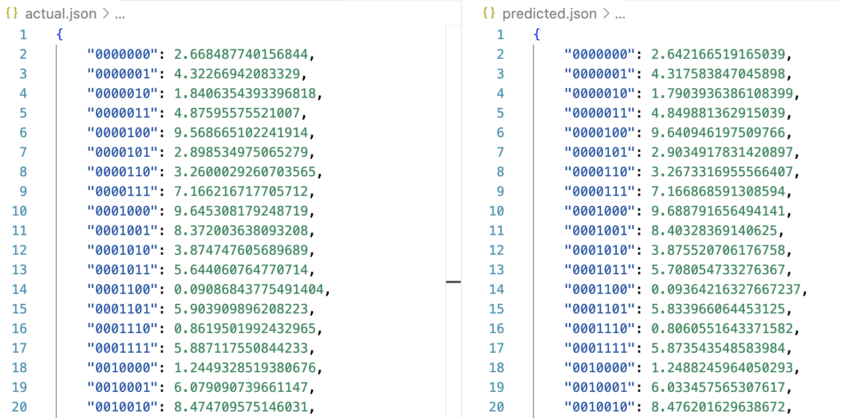
analysis
Run Index | Epochs | Total Samples | Test MSE
1 | 30 | 10⁶ | 2.237 x 10⁻¹¹
2 | 200 | 10⁵ | 9.936 x 10⁻¹¹
3 | 1.7 x 10³ | 10⁴ | 1.853 x 10⁻⁹
4 | 4 x 10³ | 5 x 10³ | 4.869 x 10⁻⁷
5 | 6 x 10³ | 3 x 10³ | 1.89 x 10⁻⁴
6 | 10 x 10³ | 10³ | 4.102

Slide 7
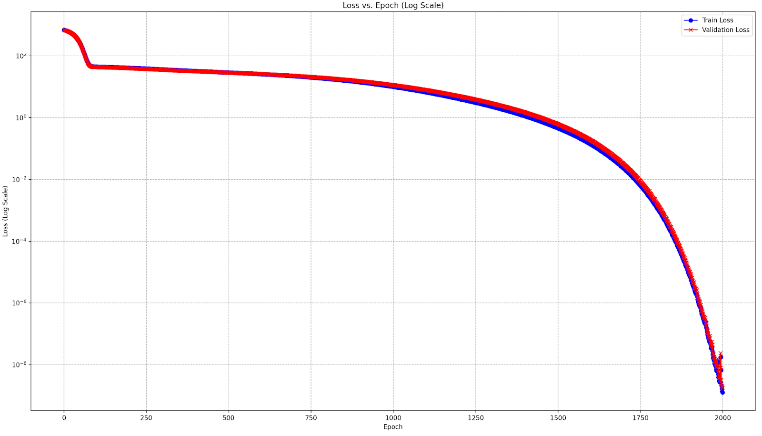
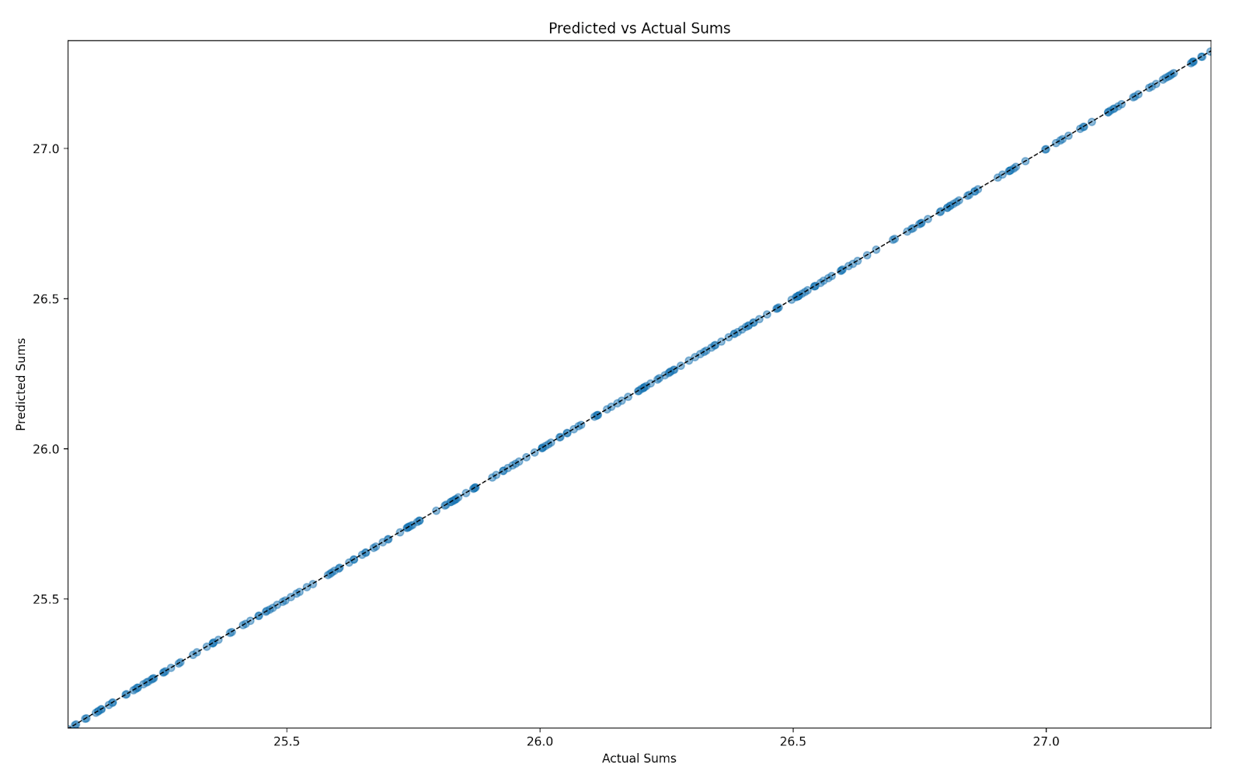
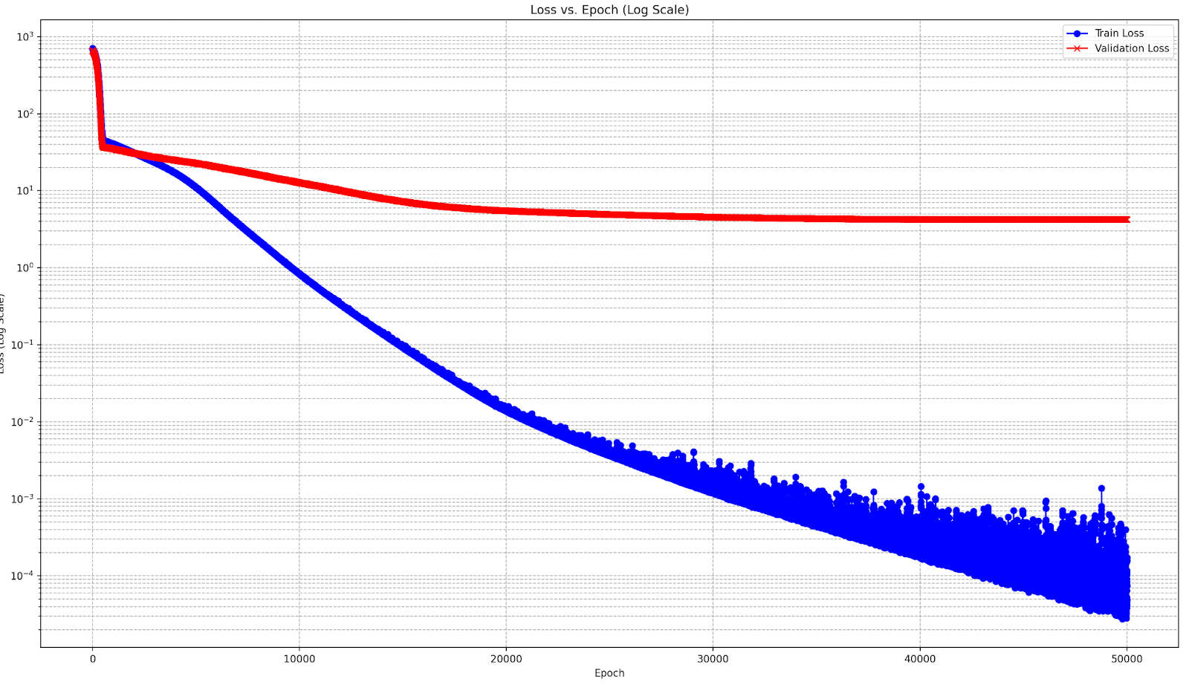
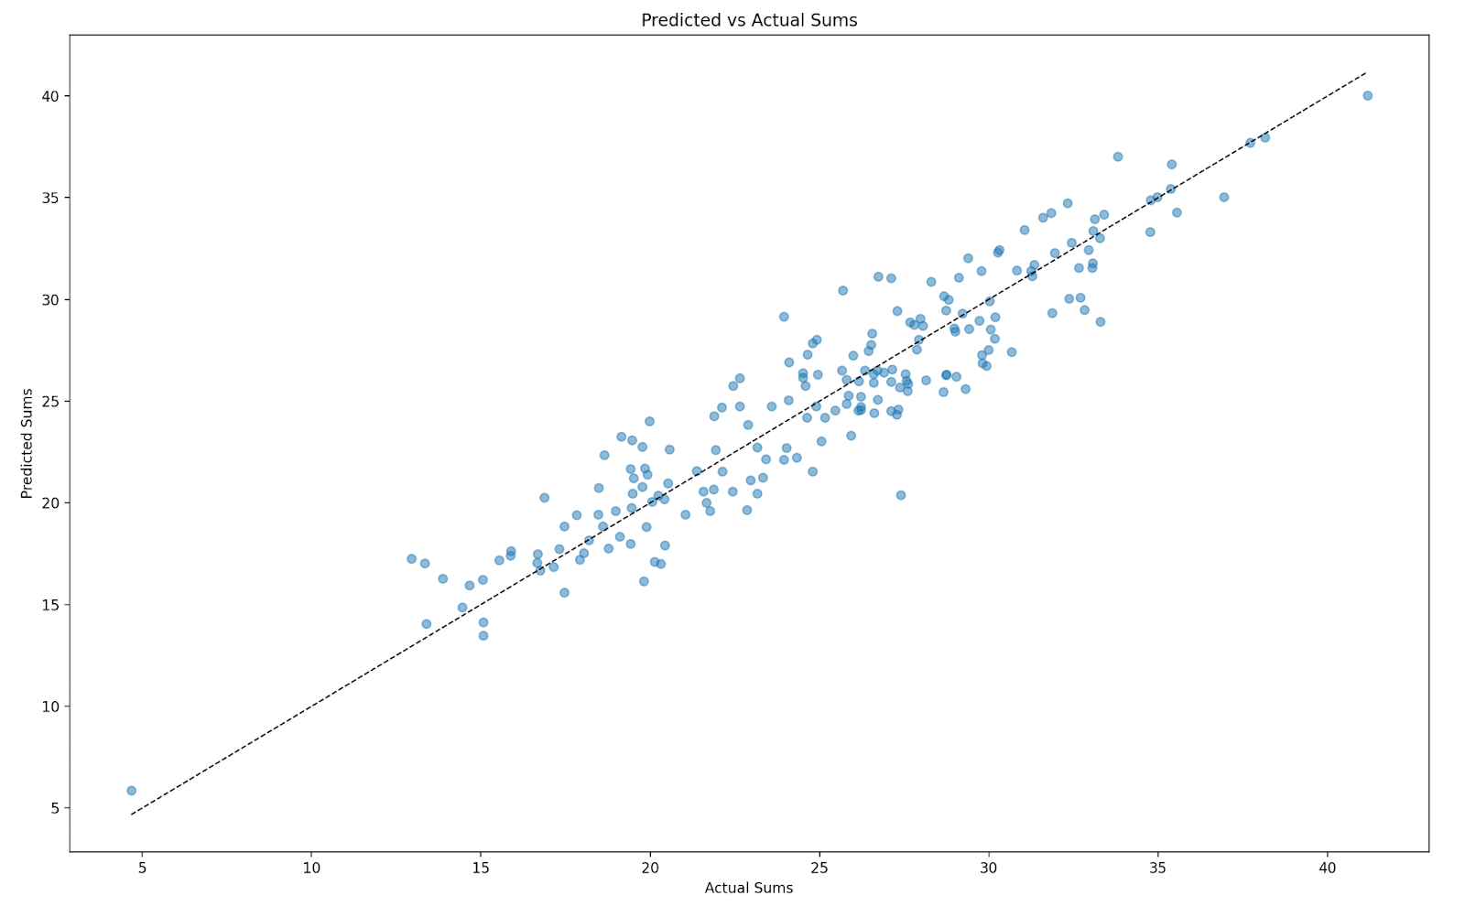
Epochs: 1.7 x 10³ | Total Samples: 10⁴ | Test MSE: 1.853 x 10⁻⁹
Epochs: 10 x 10³ | Total Samples: 10³ | Test MSE: 4.102

Slide 8
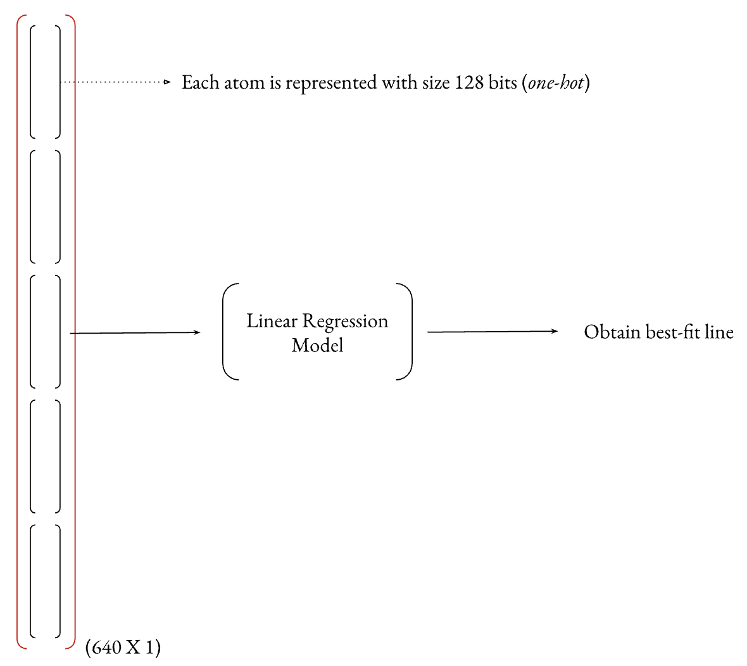
Linear regression
Models the relationship between two variables (input and output) by fitting a linear equation to observed data
y = mx + c (straight line)
7-bit representations are not useful with linear regression
Consider the 2-atom problem, where two atoms (each 7-bit) is represented using a long 14-bit sequence meaning that each bit is treated as an independent feature, but the mapping from the 7-bit sequence to its decimal representation is non-linear (exponential)
128-bit one hot encoding
[0 0 0 0 0 0 0 0 0 0 0 0 0 0 0 0 0 0 0 0 0 0 0 0 0 0 0 0 0 0 0 0 0 0 0 0 0 0 0 0 0 0 0 0 0 0 0 0 0 0 0 0 0 0 0 0 0 0 0 0 0 0 0 0 0 1 0 0 0 0 0 0 0 0 0 0 0 0 0 0 0 0 0 0 0 0 0 0 0 0 0 0 0 0 0 0 0 0 0 0 0 0 0 0 0 0 0 0 0 0 0 0 0 0 0 0 0 0 0 0 0 0 0 0 0 0 0 0]

Slide 9
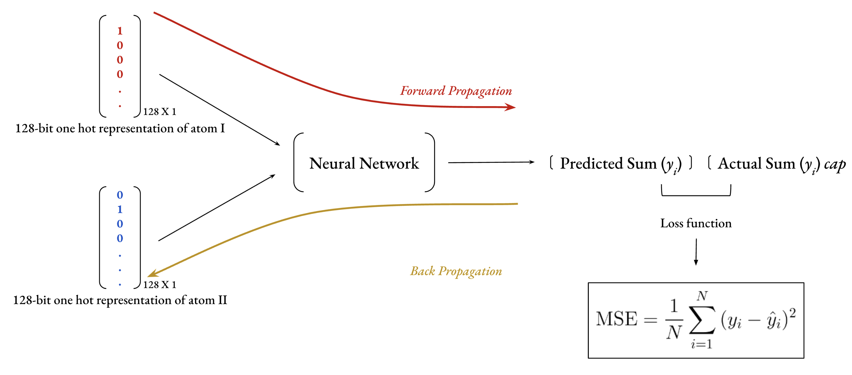
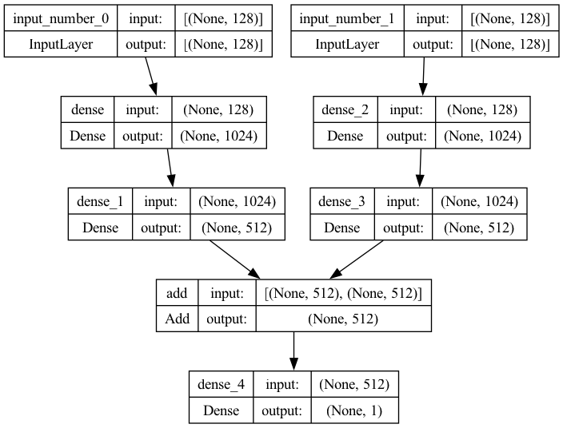
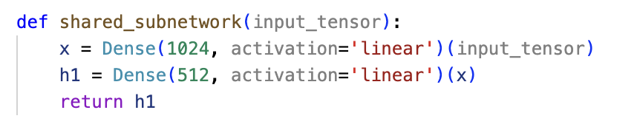
TWO-ATOM PROBLEM
[0 0 0 0 0 0 0 0 0 0 0 0 0 0 0 0 0 0 0 0 0 0 0 0 0 0 0 0 0 0 0 0 0 0 0 0 0 0 0 0 0 0 0 0 0 0 0 0 0 0 0 0 0 0 0 0 0 0 0 0 0 0 0 0 0 1 0 0 0 0 0 0 0 0 0 0 0 0 0 0 0 0 0 0 0 0 0 0 0 0 0 0 0 0 0 0 0 0 0 0 0 0 0 0 0 0 0 0 0 0 0 0 0 0 0 0 0 0 0 0 0 0 0 0 0 0 0 0]

Slide 10
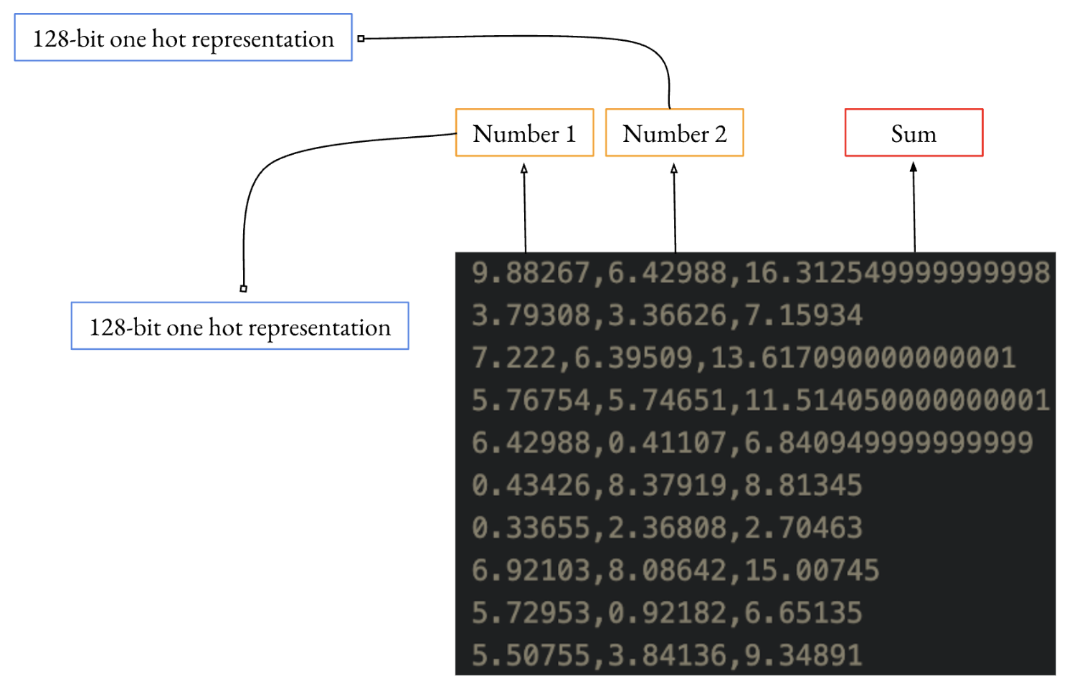
DATA REPRESENTATION

Slide 11
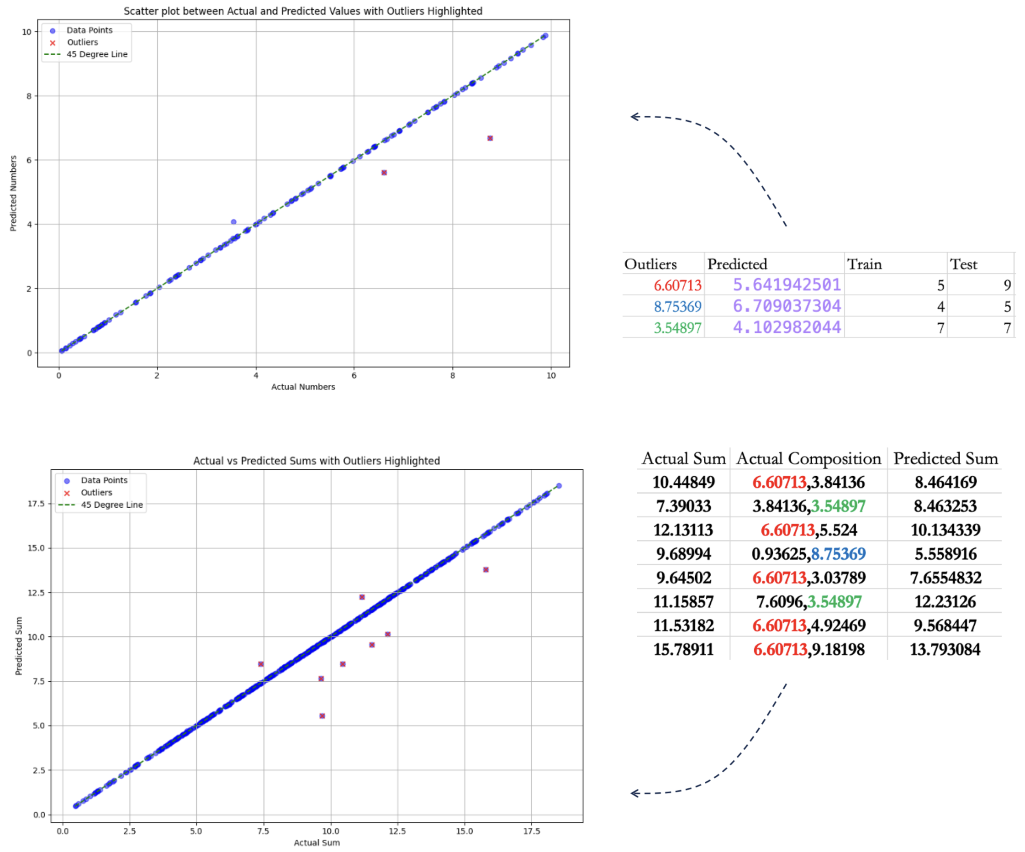
baseline model
50-50 split – 500 samples in training and 500 samples in testing
8 sum outliers
3 individual number outliers

Slide 12
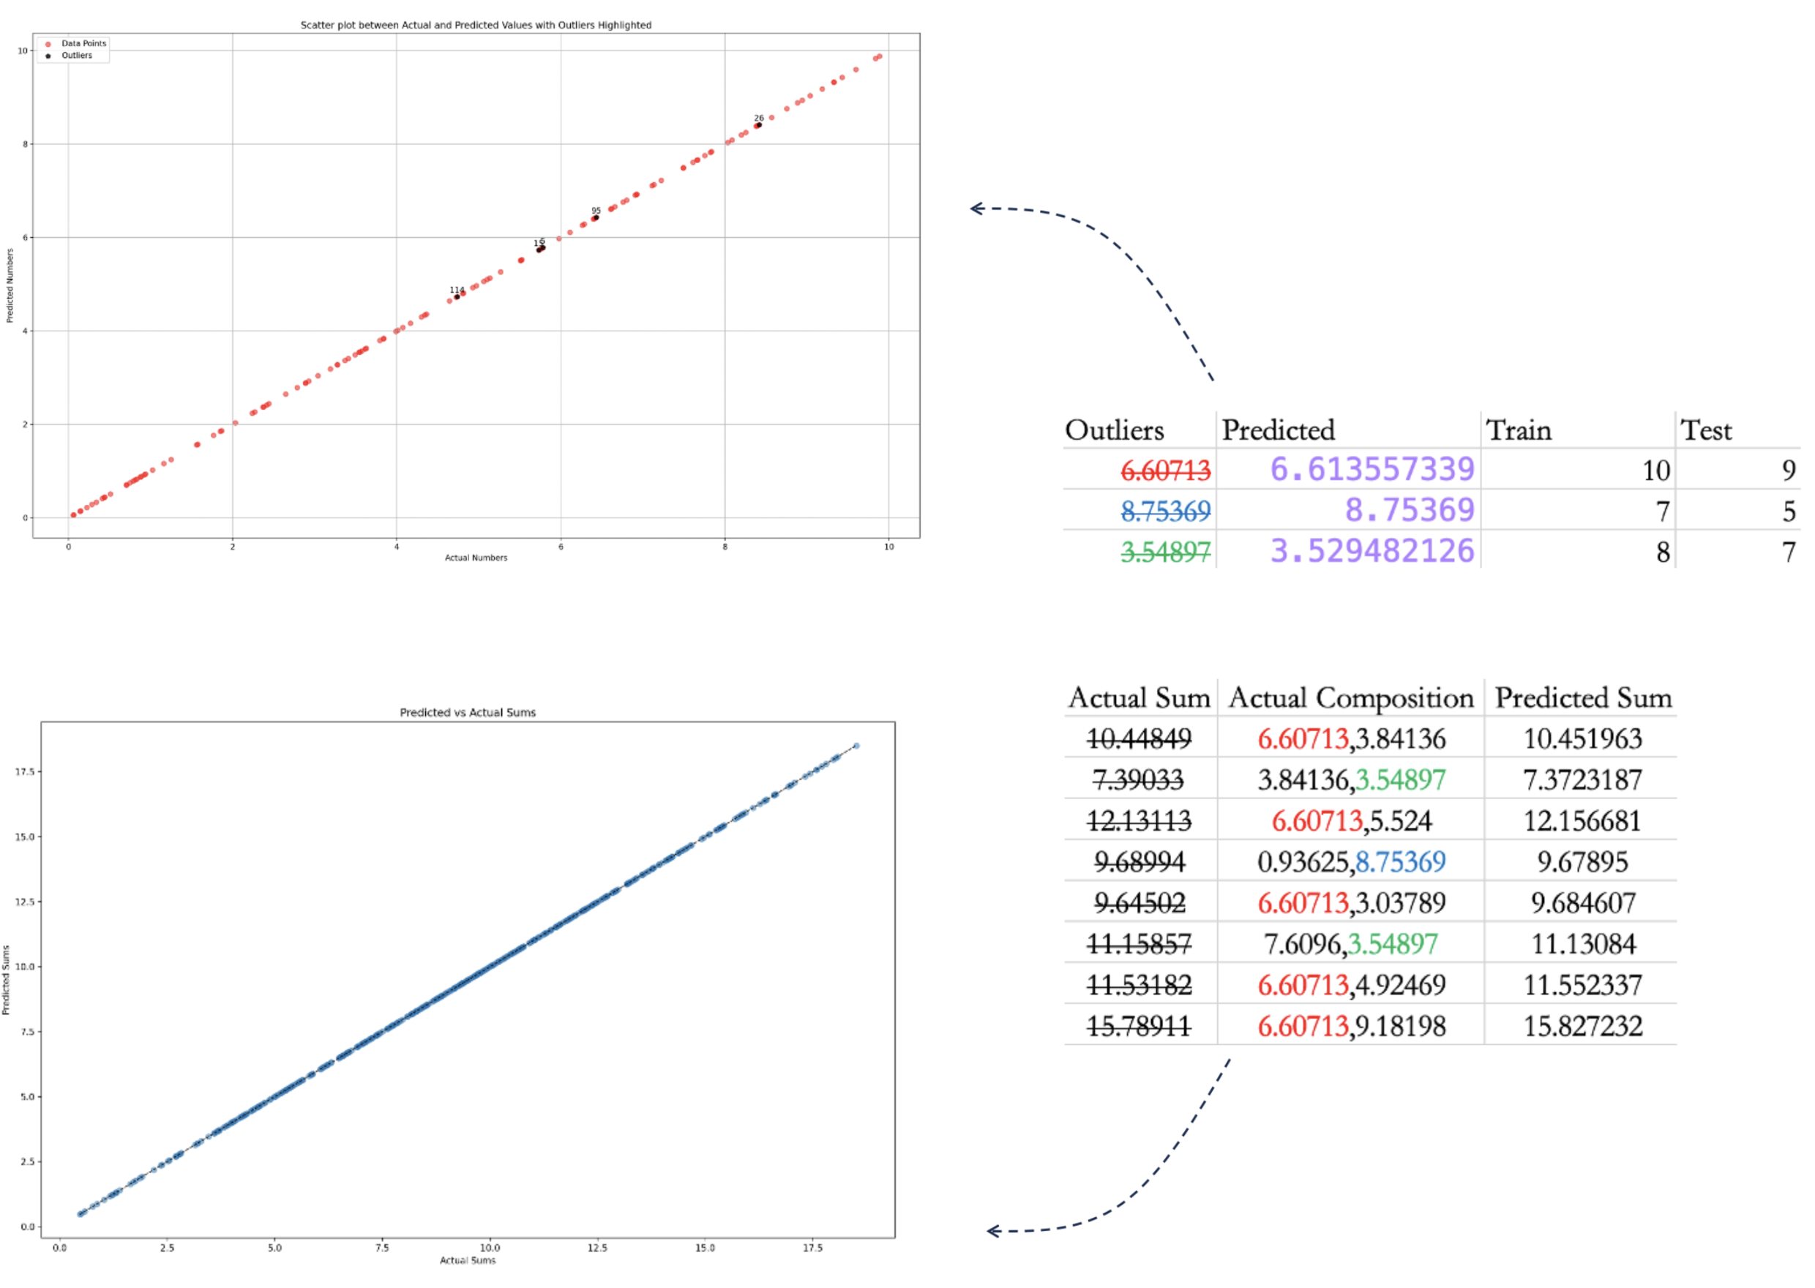
TWEAKED model
50-50 split – tweaked dataset
0 sum outliers!
0 individual number outliers!

Slide 13
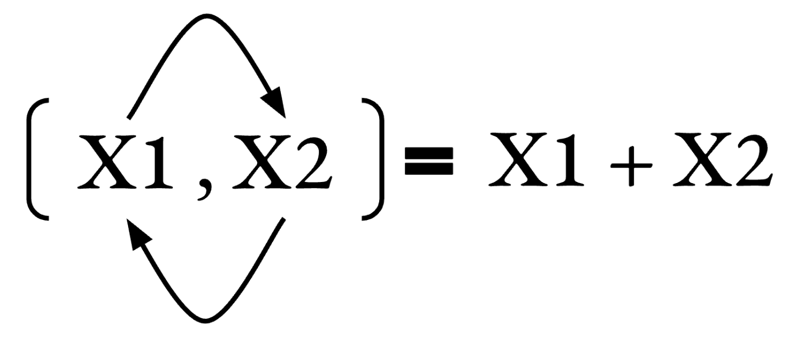
What’s next?
Contextual based - environment of the number in the pair matters?
How do some numbers that occur less frequently predicted accurately?

Slide 14
